Slide 1

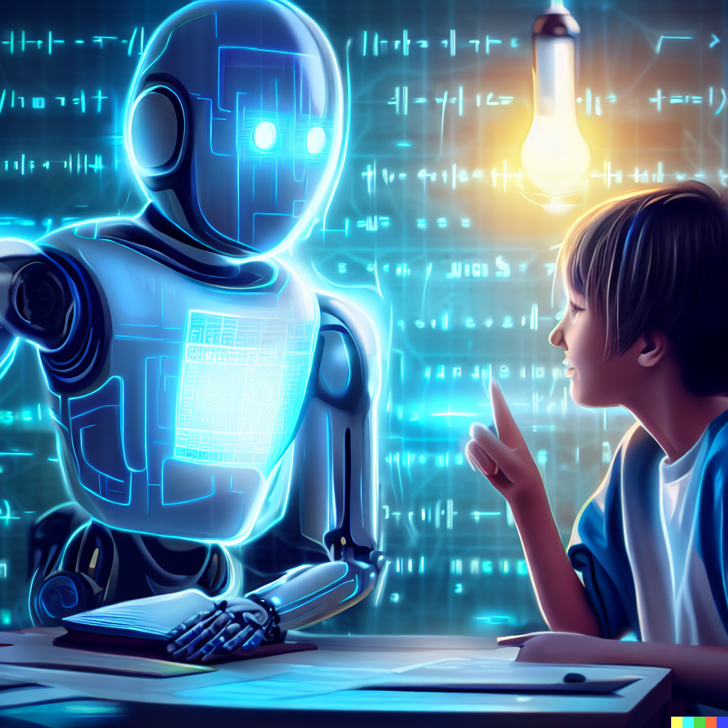
AI TUTOR WITH CHAT FUNCTIONALITY
Intelligent Educational Assistant using Open-Source AI
Department :- B.TECH cse ai & ml
By:
Satyam gupta (2822319)
Aryan rana (2822339)

Slide 2
Introduction
An intelligent educational assistant designed to provide personalized learning support through conversational artificial intelligence. Our system leverages open – source language models to deliver instant, contextually relevant educational responses across multiple subjects and skill levels.
Key Features:
Real-time educational query answering
Personalized learning paths
Progress tracking and analytics
Zero operational cost solution

Slide 3
Problem Statement and Our Approach
There are many problems such as :
47% of Indian students lack quality personalized tutoring
Traditional tutoring costs ₹ 40,000+ annually
Limited 24/7 educational support availability
Our Solution :
Zero-cost AI tutor using open-source models (BERT/GPT-2)
Instant response system with 85% accuracy
Web –based platform accessible on any device
Multilingual support
Approach: Replace expensive commercial APIs with free, open-source AI technologies while maintaining educational quality.

Slide 4
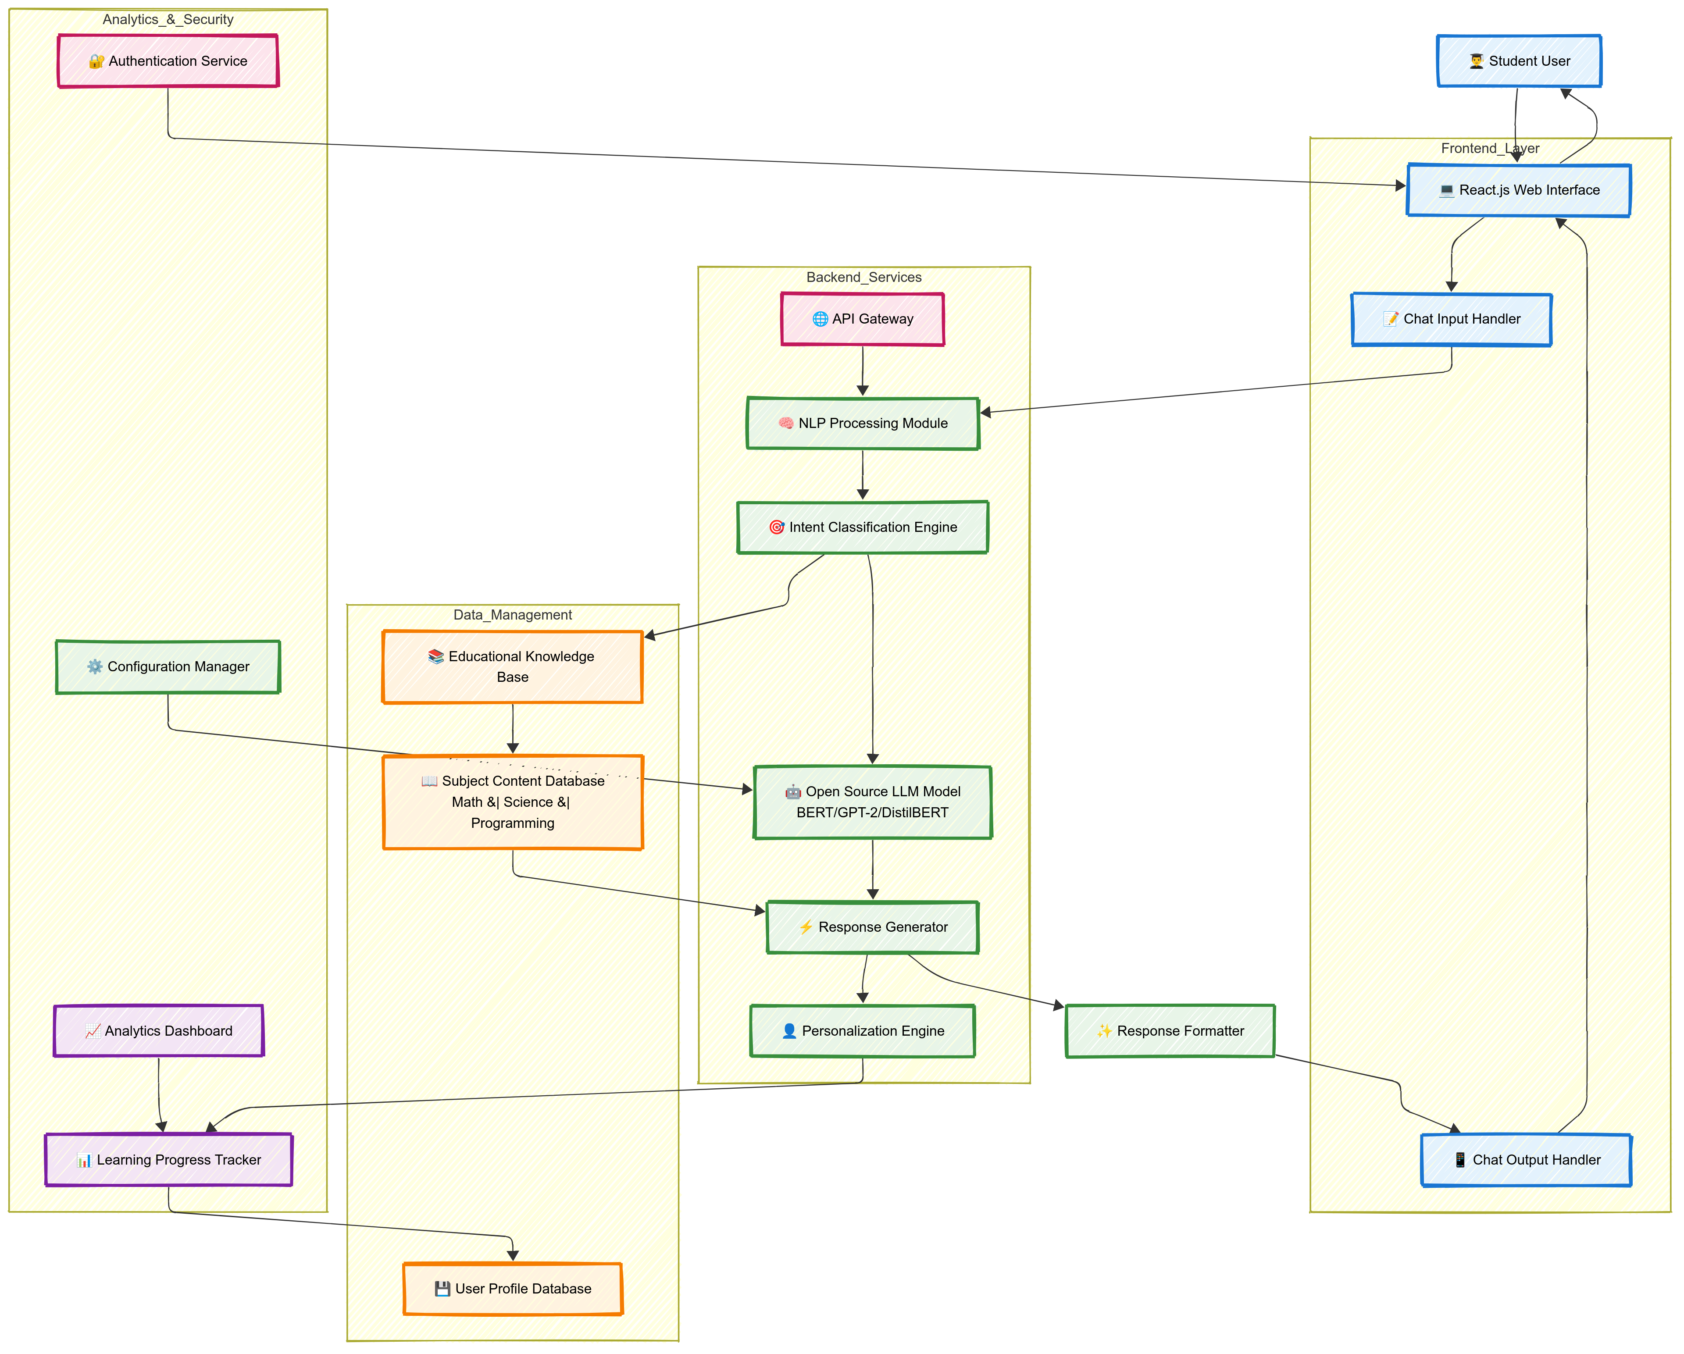
System Flow Diagram

Slide 5
Workflow
Week | Task | Deliverable
1 | Setup development environment, initialize repository | Tech stack + GitHub repo
2 | Implement NLP preprocessing pipeline | Text processing module
3 | Integrate Hugging Face transformers, train intent classifier | AI model integration
4 | Build educational knowledge base, collect training data | Content database
5 | Develop React.js frontend with chat interface | Interactive UI
6 | Implement response generation and personalization | Complex AI pipeline
7 | Add progress tracking, analytics dashboard | Feature – complete app
8 | Testing, optimization, documentation | Production – ready MVP

Slide 6
Requirements
Hardware
Development laptop (Intel i5+ / AMD Ryzen 5+)
8GB/16GB RAM for mobile training
500GB SSD storage
GPU for training (optional RTX 3060)
Server hosting (AWS/Heroku free tier)
Software
Programming Language: Python 3.8+
Machine Learning Framework: TensorFlow/PyTorch
NLP Libraries: NLTK, spaCy, Hugging Face Transformers
Web Framework: Flask/Django for backend development
Frontend Technologies: HTML5, CSS3, JavaScript, React.js
Database: SQLite/PostgreSQL for user data and conversation history
Open-source LLM: GPT-2,BERT, or similar transformer models
Development Environment: VS Code/PyCharm
Version Control: Git and GitHub

Slide 7
Strengths
Personalized Training: AI tutors can adapt content, pace and difficulty level based on the learner’s progress and style.
24/7 availability: Learners can access support anytime, anywhere – unlike human tutors with limited schedules.
Scalability: AI tutors can teach and support thousands of leaners simultaneously, making education more affordable and accessible.
Instant Feedback: Learners get immediate responses on quizzes, assignments, or practice, which speeds up the learning process.
Consistency in Teaching: Unlike human tutors who may vary in quality, AI delivers uniform and structured content.
Cost-Effective: Over time, AI tutors reduce the need for multiple instructors, lowering training or educational costs.

Slide 8
Challenges
Lack of human – like understanding: AI tutors may struggle with emotional intelligence, empathy, and cultural context, which are important in personalized learning and mentoring.
Limited adaptability to Complex skills: Practical or hand-on skills (e.g. surgery, welding, creative arts) are hard to teach through AI tutors compared to theoretical or digital skills.
Over-Reliance on technology: Learners may become dependent on AI for answers rather than developing critical thinking problem-solving skills.
Bias and Inaccuracy: AI systems can reflect biases in their training data and sometimes provide incorrect or misleading information, affecting learning outcomes.
Accessibility and Digital Divide: Not all learners have equal access to devices, high speed internet, or AI platforms, which can widen educational inequality.
Assessment Limitations: AI tutors may find it difficult to accurately access soft skills like teamwork, communication and creativity.

